Slide 1
Image Style Transfer Based on DPN-CycleGAN
Ruthwik Reddy [A20560321]
Shivaji Pannam [A20551677]

Slide 2
Problem Statement :
Image style transfer is a challenging task in image generation, where the goal is to transfer the artistic style of one image (e.g., a painting) to another image while preserving the content.
Traditional methods, such as those based on Generative Adversarial Networks (GANs), often require paired datasets, which are difficult to obtain.
In addition, these methods may suffer from high computational complexity and poor image quality.

Slide 3
Objective
Background:
GAN: Consists of Generator and Discriminator and corresponding losses.
CycleGAN - Cycle-Consistent GAN - for unpaired image to image translation without requiring paired training data.
DPN : Combines the strength of ResNet and DenseNet.
The key improvements include:
Introducing identity loss to preserve original image features during style transfer.
Replacing the ResNet-based generator with a Dual Path Network (DPN) based one.
Notes:
The research proposes an improved version of CycleGAN, called DPN-CycleGAN, which aims to enhance the quality of style-transferred images by addressing the limitations of traditional methods.
Improve loss function, by introducing identity loss to total loss
Replace resnet with DPN which is RESNET+DENSENET, to reduce computational complexity and improve image quality.

Slide 4


Proposed Model
Improvement of Loss Function :
Where Identity Loss ( L id) is,
Notes:
Identity Loss: Added to preserve the content and structure of the original image during style transfer. This loss ensures that when an image from domain Y is passed through the generator meant for domain X, it remains unchanged.

Slide 5
Proposed Model
B. Improvement of Network Structure :
Generator Architecture:
Composed of three parts: encoder, converter (DPN), and decoder.
The encoder extracts features from input images using convolutional layers.
The DPN transforms features from one domain to another.
The decoder reconstructs the output image from transformed features using deconvolution layers.
Notes:
We are making changes in the Generator architecture, these are the key changes:
As you know, there are three parts of GAN, point 1
These do the following, point 2 and 3

Slide 6
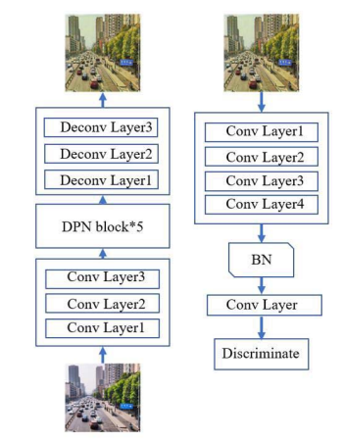
Implementation Model:
Adding Loss function
Generator pointing to DPN Block Instead of a ResNet block for the converter
The DPN block consists of Residual ResNet path and Deep Convolutional DenseNet path
Batch Normalization and ReLu activation between layers.

Slide 7
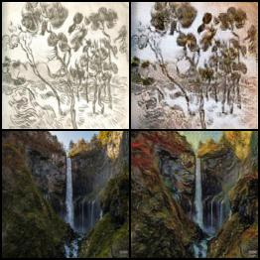
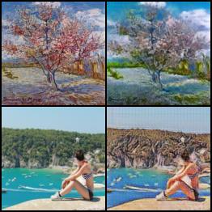
Results :

Slide 8
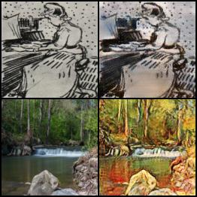
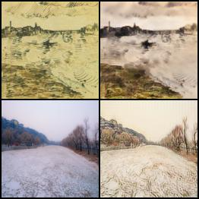
Results :

Slide 9
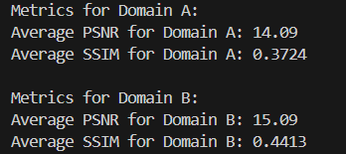
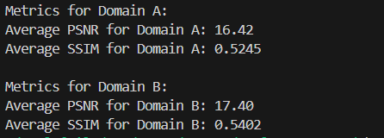
Quantitative Results :
II. With DPN-CycleGAN
As the model was only trained for 100 epochs, the average PSNR and SSIM scores are slightly lower compared to the results reported in the research paper.
With Identity Loss

Slide 10
Conclusion :
In summary, this research presents an improved CycleGAN model, DPN-CycleGAN, which enhances both efficiency and quality in image style transfer tasks.
By incorporating identity loss and replacing ResNet with Dual Path Network in the generator architecture, this model achieves faster convergence and better performance compared to classical CycleGAN.

Slide 11
Thank You!!

